Slide 1

Fingerprint Recognition
Morgan Leake and Rochelle Mattern
Digital Signal Processing

Slide 2
Outline of Discussion
Background
Preprocessing of Images
Our Method of Recognition
Challenges Encountered

Slide 3
Background
Reasons to use fingerprints as a form of identification:
Universal to all humans
Unique to each person
Remain consistent with age

Slide 4
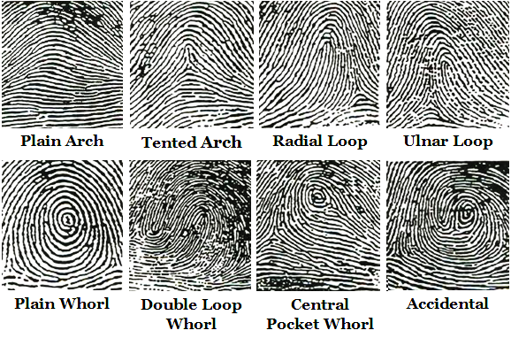
Background
FBI classifies fingerprints into eight groupings:

Slide 5
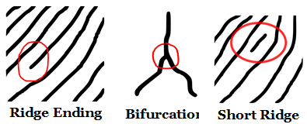
Background
Most commonly used Algorithm today: Minutiae
Minutiae points are points of ridge endings, bifurcations, and short ridges
Two algorithms used to compare minutiae points on fingerprints:
Spaced Frequency
Line Scanning

Slide 6
Preprocessing of Images
Preprocessing of images almost always necessary for ANY algorithm used
Preprocessing used includes:
Converting to gray scale (rgb2gray)
Resize/Adjust
Thinning
Edge detection

Slide 7
Preprocessing of Images

Slide 8
Our Method of Recognition
Database of fingerprints

Slide 9
Our Method of Recognition

Slide 10
Our Method of Recognition
Autocorrelation of unknown fingerprint
Cross-correlation of unknown fingerprint with select fingerprints from database

Slide 11
Mesh of Correlation

Slide 12
Slice of Correlation Graphs

Slide 13
Difference Graphs

Slide 14
Our Method of Recognition
Compare the difference graphs
Square each element in each array
Sum all elements in array
Lowest sum results in match

Slide 15
Results

Slide 16
Challenges Encountered
Preprocessing
With 2D correlation
Requires 2D array
‘conv2’ must be flipped both directions
Automating a match

Slide 17
Questions?

